Slide 1
Department of Environmental Quality
May 11, 2016

Slide 2
Current Status of GUC 609 request
Harold Brady
Division of Water Resources Department of Environmental Quality
EMC Water Allocation Committee
May 11, 2016

Slide 3
Current Status
GUC is currently under contract with Hazen and Sawyer to produce revised water supply demand projections and potential changes/upgrades to the distribution system and plant to alleviate “bottlenecks” to provide additional supply when needed.
This could postpone/delay an expensive WTP expansion that is still projected to be needed in the future; however, the timing/year of any projected shortfall based on the current WTP capacity is currently under review.
The report plan containing revised demand projections and distributional/operational changes is expected to be finalized in early to mid 2017.

Slide 4
Timeline
Jan. 1983: WTP came on-line.
Oct. 1997: Letter from DWR stating that additional flow studies will be required when requesting any expansions above 22.5 MGD. None were required for the 15 to 22.5 expansion in 2002, due to tidal influence, even though the 20% 7Q10 threshold was exceeded.
2002: WTP expansion 15 to 22.5 MGD
Aug. 2006: 1st IBT meeting with DWR
Late 2007: Draft IBT EA submitted, comments provided Feb. 2008 & Sept. 2008
Sept. 2008: Scoping Document for Proposed Intake
Oct. 2008: Final IBT EA submitted
Nov. 2008: TAG kickoff meeting
Dec. 2008: FONSI for IBT EA issued
Dec. 2008: Draft EA for new intake submitted, comments provided January 2009.
April 2009: FONSI for new intake issued
May 2009: Draft IBT Petition
Nov. 2009: Public Hearing for IBT Certificate
June/July 2010: IBT Management Strategy TM to EMC
Nov. 2010: IBT Certificate issued that included Greene County, Farmville, and Winterville
Early 2011: TAG TM #1 Study Plan
June 2011: Draft Population and Water Demand Update completed
Dec. 2011: TAG TM #2 Selection of Hydrologic Model, TAG TM #3 Mussel Survey, TAG TM #4 Screening Analysis, TAG TM #5 Withdrawal Analysis
March 2012: TAG TM #6 EFDC Model Documentation
July 2012: Signed Resolution for HB 609 Assistance
Oct. 2012: TAG TM #7 Effects of Future Flow Withdrawals on Salinity-Mediated Habitats
April 2012: Greene County opposition letter to GUC IBT Certificate Requirements
Sept. 2012: HB609 Presentation from GUC on Long Range Water Supply Options
Nov. 2012: Overview of Tar River Flow Study Submitted
Feb. 2013: Meeting with GUC to discuss timeline for Tar River model for EMC consideration.
April 2013: Tar River Flow Study Report – Final TAG Report
Nov. 2013: Revised timeline from DWR proposing models to WAC in March 2014 and EMC in May 2014
Dec. 2013: DWR provided OASIS and EFDC model training
Jan. 2014: Temp. CCPCUA Permit granted to Greene County
Oct. 2014: Agency meeting
Jan. 2015: email from DWR describing the current status regarding the HB609 request, WTP expansion.
Notes:
“On behalf of GUC, we plan to establish a Technical Advisory Group (TAG) that will work with GUC and its environmental and engineering consultants (ENTRIX and ARCADIS) regarding the study needs and environmental issues, development of a detailed study plan, river modeling, habitat analysis, and reporting related to flows appropriate for the Tar River. The goal of the Tar River Flow Study is to identify the environmental issues and potential constraints associated with water withdrawals in the Tar River, and provide the basis for evaluating the potential effects of increased withdrawals on instream habitat, water quality, and aquatic resources and values. The study results will also help GUC understand and address operational issues such as the location of the fresh-salt water interface and concerns about saltwater encroachment upriver during periods of low inflow or drought.” --email from Lauren Elmore (Entrix) inviting participants to join the TAG
TM #1: “GUC has initiated this planning study to evaluate the issues associated with future flow conditions and a range of water withdrawals. GUC does not intend to request a permit for a water treatment plant expansion as a part of this instream flow study. GUC is investigating the capacity of the Tar River to support additional future water withdrawal under various flow conditions, particularly low flows. This investigation is not associated with a specific proposed water withdrawal amount at this time. However, the study will be valuable for identifying the flow ranges within which additional withdrawals are supported while maintaining beneficial habitat and water quality conditions in the lower Tar River. The ultimate goal of the study is to provide a sound basis for planning and to establish the scientific basis for GUC’s future water withdrawal permit applications.”

Slide 5
Major Events
Oct. 1997:
April 2009:
Nov. 2010:
July 2012:
April 2013:
Jan. 2015:
Letter from DWR stating that additional flow studies will be required when requesting any expansions above 22.5 MGD.
None were required for the 15 to 22.5 expansion in 2002, due to tidal influence, even though the 20% 7Q10 threshold was exceeded.
FONSI for new intake issued
IBT Certificate issued that included Greene County, Farmville, and Winterville
Signed Resolution for HB 609 Assistance
Tar River Flow Study Report – Final TAG Report
DWR email describing the current status regarding the HB609 request, WTP expansion.

Slide 6
Contact Information
Harold Brady
Division of Water Resources
919-707-9005
harold.m.brady@ncdenr.gov
Department of Environmental Quality

Slide 7
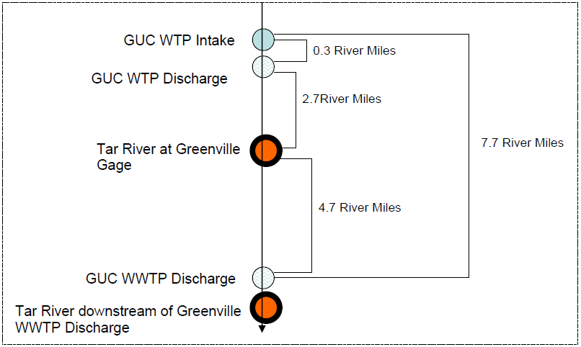
Water Withdrawal and Discharge Schematic

